Slide 1
Nuts and Bolts of the US Medicare Reimbursement System
Orlando P. Simonetti, PhD, FSCMR, FISMRM, FAHA
Victor A. Ferrari, MD, FSCMR, FACC
Thursday, February 7, 2019

Slide 2
What is Medicare?
Medicare is health insurance for people:
  65 and older
  Under 65 with certain disabilities, e.g., ALS and end-stage renal disease
Medicare currently provides health insurance for
  58.6 million US residents
    49.3 million 65 and older
    9.3 million with qualified disabilities
  18% of the US population
Notes:
OPPS = hospital outpatient prospective payment system
Professional fees come under Medicare Physician Fee Schedule (this is for physician services, including interpretation and written report) even if services provided under OPPS
TC =

Slide 3
The Medicare population is growing
10,000 “Baby Boomers”
turn 65 every day
Today > 15% of population is 65 or over; by 2030, > 20%
Notes:
OPPS = hospital outpatient prospective payment system
Professional fees come under Medicare Physician Fee Schedule (this is for physician services, including interpretation and written report) even if services provided under OPPS
TC =

Slide 4
CV disease is more prevalent in older population
Difficult to determine the proportion of all CMR scans paid by Medicare, but CV disease prevalence increases with age.
35.5% of >62,000 CMR studies in the SCMR Registry were performed on patients aged 65 and older.
Medicare coverage and reimbursement are clearly important to the financial sustainability and growth of CMR
Many insurers use Medicare coverage decisions to guide them
Notes:
OPPS = hospital outpatient prospective payment system
Professional fees come under Medicare Physician Fee Schedule (this is for physician services, including interpretation and written report) even if services provided under OPPS
TC =

Slide 5
Coverage vs Reimbursement
Coverage
  Defined list of services that insurer will cover
  Specific exclusions
  Medicare - Treatment must be “reasonable and necessary” for the care of the patient
  Private payer coverage criteria vary
Reimbursement
  Payment to a hospital, physician, or provider for services rendered to a beneficiary
  Medicare rates are published annually
  Regional variability
  Private payer rates not made public, difficult to ascertain: intentionally non-transparent to maintain competitive advantage in marketplace
Notes:
Before we get started with our discussion, we should carefully define our terms so as to avoid confusion. Health policies are guidelines for determining coverage for a specific medical technology, in this case cardiac CT. Conversely, coverage refers to the list of benefits that a healthcare management entity provides to all persons within a specific region. While straightforward, significant national variability between insurers and regional variability within a given insurer exists. Further muddying the waters is the fact that the indications for which various insurers will cover cardiac CT is also highly variable and in many instances not readily available for review.
Reimbursement, on the other hand, refers to the way and amount that a particular insurer or payer agrees to pay for medical services rendered to a beneficiary. Much like coverage, there is significant variability in reimbursement rates both nationally and regionally.

Slide 6
Medicare Coverage Determination
National Coverage Determinations (NCD)
  Nationwide coverage for an item or service
  Represents only about 10% of coverage determinations, the rest are LOCAL
Local Coverage Determinations (LCD)
  Seven regional Medicare Administrative Contractors (MACs)
    Novitas, Noridian, Palmetto, First Coast, Wisconsin Physician Services, CGS, NGS
  Each MAC has its own set of LCDs
  CMR is not addressed in any LCDs
    CMR claims are adjudicated on a case by case basis
  Area of ongoing advocacy focus by SCMR: let us know how we can help you!
Notes:
Before we get started with our discussion, we should carefully define our terms so as to avoid confusion. Health policies are guidelines for determining coverage for a specific medical technology, in this case cardiac CT. Conversely, coverage refers to the list of benefits that a healthcare management entity provides to all persons within a specific region. While straightforward, significant national variability between insurers and regional variability within a given insurer exists. Further muddying the waters is the fact that the indications for which various insurers will cover cardiac CT is also highly variable and in many instances not readily available for review.
Reimbursement, on the other hand, refers to the way and amount that a particular insurer or payer agrees to pay for medical services rendered to a beneficiary. Much like coverage, there is significant variability in reimbursement rates both nationally and regionally.

Slide 7
Medicare covers the CMR CPT* Codes
AMA Category 1 CMR CPT Codes (beginning 2008)
  75557 – Cardiac magnetic resonance imaging for morphology and function without contrast material
  75559 – Cardiac magnetic resonance imaging for morphology and function without contrast material; with stress imaging
  75561 – Cardiac magnetic resonance imaging for morphology and function without contrast material(s), followed by contrast material(s) and further sequences
  75563 – Cardiac magnetic resonance imaging for morphology and function without contrast material(s), followed by contrast material(s) and further sequences; with stress imaging
  75565 – Cardiac magnetic resonance imaging for velocity flow mapping; add on code
Without
contrast
With
contrast
*CPT = Current Procedural Terminology
Notes:
As of 2010, there are currently 4 category 1 codes that apply to CCTA: one code for calcium scoring and 3 codes for contrast-enhanced CT for structural evaluation, congenital assessment, or for angiography. Due to significant effort on the part of SCCT and other entities, cardiac CT is currently assigned the highest work RVU value of any other CT application, but in this era of significant cost constraint, ongoing diligence is required.
DRA =deficit reduction act of 2005: limits payment under physician fee schedule for CCT to the payment amount determined under the OPPS (professional component unaffected). The MPFS contains both regular and OPPS payments for technical component (TC) of imaging. The lower of the 2 amounts will be paid. If OPPS payment is the lowest amount, then that particular imaging service is deemed subject to cap. 26 modifier is the PC
MPFS = CMS Physician Fee Schedule
HOPPS = Outpatient prospective payment system

Slide 8
Medicare Reimbursement
Some Definitions
  Outpatient Prospective Payment System (OPPS)
    prospective payment system to pay for most hospital outpatient services, and partial hospitalization services.
    “Technical Component” for outpatient imaging covering the cost of equipment, supplies, and personnel needed to perform the service.
  Medicare Physician Fee Schedule (MPFS)
    Medicare Part B pays for physician services based on the MPFS, which lists the more than 7,000 unique codes and their payment rates.
    “Professional Component” for imaging services covers physician time and expertise required to interpret and report the study.
Notes:
As of 2010, there are currently 4 category 1 codes that apply to CCTA: one code for calcium scoring and 3 codes for contrast-enhanced CT for structural evaluation, congenital assessment, or for angiography. Due to significant effort on the part of SCCT and other entities, cardiac CT is currently assigned the highest work RVU value of any other CT application, but in this era of significant cost constraint, ongoing diligence is required.
DRA =deficit reduction act of 2005: limits payment under physician fee schedule for CCT to the payment amount determined under the OPPS (professional component unaffected). The MPFS contains both regular and OPPS payments for technical component (TC) of imaging. The lower of the 2 amounts will be paid. If OPPS payment is the lowest amount, then that particular imaging service is deemed subject to cap. 26 modifier is the PC
MPFS = CMS Physician Fee Schedule
HOPPS = Outpatient prospective payment system

Slide 9
Medicare Reimbursement
Some Definitions
  Inpatient Prospective Payment System (IPPS)
    prospective payment system to pay for inpatient stays.
    A hospital receives a single payment for the case based on the payment classification -- MS-DRGs (Medicare Severity Diagnosis-Related Groups)
Notes:
As of 2010, there are currently 4 category 1 codes that apply to CCTA: one code for calcium scoring and 3 codes for contrast-enhanced CT for structural evaluation, congenital assessment, or for angiography. Due to significant effort on the part of SCCT and other entities, cardiac CT is currently assigned the highest work RVU value of any other CT application, but in this era of significant cost constraint, ongoing diligence is required.
DRA =deficit reduction act of 2005: limits payment under physician fee schedule for CCT to the payment amount determined under the OPPS (professional component unaffected). The MPFS contains both regular and OPPS payments for technical component (TC) of imaging. The lower of the 2 amounts will be paid. If OPPS payment is the lowest amount, then that particular imaging service is deemed subject to cap. 26 modifier is the PC
MPFS = CMS Physician Fee Schedule
HOPPS = Outpatient prospective payment system

Slide 10
MPFS: Medicare Physician Fee Schedule
US Medicare/Medicaid MPFS Professional Fees
CPT Code | Description | 2016 | 2017 | 2018 | 2019 | %Change 2016 to 2019
75557 | CMR morphology and function without contrast | $ 117.87 | $ 118.43 | $ 118.44 | $ 118.57 | 1%
75559 | CMR morphology and function without contrast, with stress | $ 145.46 | $ 145.46 | $ 146.16 | $ 145.96 | 0%
75561 | CMR morphology and function with contrast | $ 130.06 | $ 130.99 | $ 130.68 | $ 130.82 | 1%
75563 | CMR morphology and function with contrast, with stress | $ 149.04 | $ 150.02 | $ 150.12 | $ 149.92 | 1%
Notes:
OPPS = hospital outpatient prospective payment system
Professional fees come under Medicare Physician Fee Schedule (this is for physician services, including interpretation and written report) even if services provided under OPPS
TC =

Slide 11
MPFS: Medicare Physician Fee Schedule
Professional Component Reimbursement and (Physician Work RVU)
2016 2017 2018 2019
75557 CMR no con 117.80 (2.35) 118.43 ( 2.35) 118.44 (2.35) 118.57 (2.35)
75559 CMR stress 146.44 (2.95) 145.46 (2.95) 146.16 (2.95) 145.96 (2.95)
75561 CMR con 129.97 (2.60) 130.99 (2.60) 130.68 (2.60) 130.82 (2.95)
75563 CMR st-con 148.95 (3.00) 150.02 (3.00) 150.12 (3.00) 149.92 (3.00)
93306 TTE 64.45 (1.30) 64.96 (1.30) 74.86 (1.50) 74.96 (1.50)
93351 Str Echo 86.29 (1.75) 86.29 (1.75) 87.12 (1.75) 87.21 (1.75)
78452 MPI 80.20 (1.62) 80.39 (1.62) 81.00 (1.62) 80.73 (1.62)
78472 MUGA 48.69 (0.98) 49.17 (0.98) 49.32 (0.98) 49.37 (0.98)
CMR RVU’s and pro fees better than echo or nuc, but not relative to the physician time required to interpret and report.
Notes:
OPPS = hospital outpatient prospective payment system
Professional fees come under Medicare Physician Fee Schedule (this is for physician services, including interpretation and written report) even if services provided under OPPS
TC =

Slide 12
Outpatient Technical Component
US Medicare/Medicaid Outpatient Payment System (OPPS) Technical Fees
Intended to cover costs of equipment, supplies, and personnel needed to perform service; not physician time

Slide 13
How does CMS set these rates?
HOW PAYMENT RATES ARE SET (published by CMS):
The payment rates for most separately payable medical and surgical services are determined by multiplying the prospectively established scaled relative weight for the service’s clinical APC by a conversion factor (CF) to arrive at a national unadjusted payment rate for the APC. The scaled relative weight for an APC measures the resource requirements of the service and is based on the geometric mean cost of services in that APC. The CF translates the scaled relative weights into dollar payment rates.
Crystal clear, right?
Notes:
OPPS = hospital outpatient prospective payment system
Professional fees come under Medicare Physician Fee Schedule (this is for physician services, including interpretation and written report) even if services provided under OPPS
TC =

Slide 14
Ambulatory Payment Classification (APC) Groups
Ambulatory Payment Classification (APC) groups were defined to capture resource consumption and clinical similarities.
Services are assigned to APC groups based on practice-reported resource costs
All services within an APC group are reimbursed at same rate
Two-Times Rule: the highest calculated cost of an individual procedure categorized to any given APC cannot exceed two times the calculated cost of the lowest-costing procedure categorized to that same APC.
Notes:
OPPS = hospital outpatient prospective payment system
Professional fees come under Medicare Physician Fee Schedule (this is for physician services, including interpretation and written report) even if services provided under OPPS
TC =

Slide 15
Imaging APC Groups
Notes:
OPPS = hospital outpatient prospective payment system
Professional fees come under Medicare Physician Fee Schedule (this is for physician services, including interpretation and written report) even if services provided under OPPS
TC =

Slide 16
Outpatient Technical Component
US Medicare/Medicaid Outpatient Payment System (OPPS) Technical Fees
Intended to cover costs of equipment, supplies, and personnel needed to perform service; not physician time

Slide 17
CMR Reimbursement
Equipment costs
MRI
  ~$1.4M purchase
  ~$125K service
Echo
  ~$180K purchase
  ~$12K service
SPECT
  ~$350K purchase
  ~$40K service
Medicare/Medicaid Outpatient Payment System (OPPS) Technical Fees
CMR Code Description | 2018 Technical Fee | Echo Code Description | 2018 Technical Fee | Nuclear code description | 2018 Technical Fee
75557 CMR morphology and function without contrast | $230.56 | 93306 Trans-thoracic echocardiography,w/Doppler, complete | $497.49
75559 CMR morphology and function without contrast, with stress | $497.49 | 93351 Trans-thoracic echo rest and stress with interpretation and report; | $497.49
75561 CMR morphology and function with contrast | $456.34 | C8929 TTE w/contrast | $691.85 | 78472 Gated MUGA study | $353.49
75563 CMR morphology and function with contrast, with stress | $691.85 | C8930 TTE w/contrast, w/stress | $691.85 | 78452 SPECT MPI, rest and stress (exercise or pharma) | $1,229.38
CMR reimbursement unfavorable compared to Echo and SPECT

Slide 18
Example: 75561 CMR w/contrast, w/o stress
APC 5572 – Level 2 Imaging with Contrast
Payment = $385.88 (same for all codes in the APC)
75561 reported costs:
  Minimum $95.42 (!)
  Maximum $1,854.37 (!)
  Geometric mean $420.81
Other codes in this APC:
  74182 MRI of the abdomen w/contrast
  70548 MRA of the neck w/contrast
  72149 MRI lumbar spine w/contrast
Notes:
OPPS = hospital outpatient prospective payment system
Professional fees come under Medicare Physician Fee Schedule (this is for physician services, including interpretation and written report) even if services provided under OPPS
TC =

Slide 19
Reimbursement Challenges - OPPS
APC placement is reviewed and revised annually by CMS
Every year, SCMR monitors and addresses with CMS any proposed changes in APC placement or APC restructuring, often partnering with other organizations (ACC, ACR, ASE).
APC placement is almost purely based on reported charges.
Systematic underreporting of charges associated with CMR(!)
Notes:
OPPS = hospital outpatient prospective payment system
Professional fees come under Medicare Physician Fee Schedule (this is for physician services, including interpretation and written report) even if services provided under OPPS
TC =

Slide 20
Common Resources Utilized for Stress CMR
Staff | Medical Supplies | Durable Equipment
Front desk – Check-in, scheduling, screening, paperwork prep | Alcohol wipes IV kit/18 g needle 10 ml syringes | MRI scanner utilization Power contrast injector ECG cables
RN/LVN – IV placement, vital signs, medication administration, recovery | NaCl flush syringes ECG electrodes Conductive Gel IV tubing extension | 3D workstation software PACS High res monitors Building costs/maintenance
Technologist – MRI suite prep, scan acquisition | Gauze non-sterile 2x2 in Bandaid | Scanner maintenance Injector maintenance
 | Adenosine (IV) Persantine (IV) Dobutamine (IV) Atropine (IV) Metoprolol (IV) | Software upgrades Specialized workstation software (Perfusion, Mapping, etc.)
 | MRI contrast agent Sterile saline (injector) | Insurance/Utilities Janitorial Services

Slide 21
Common Resources Utilized for Stress CMR
Staff | Medical Supplies | Durable Equipment
Front desk – 15 min | Supplies - $35.00/scan | MRI scanner - $150/scan Contrast Injector - $5/scan
RN/LVN – 30-120 min Supervisor – 15 min | Persantine - $25/scan (IV) Adenosine - $150/scan (IV) Atropine - $20/2 mg IV Metoprolol tartrate - $7/15 mg IV | Workstation Software - $10/scan PACS - $3.50/scan Building costs/maintenance - $5/scan
Technologist – 45-60 min | MRI contrast - $200/scan Sterile saline - $70/scan | Insurance/Utilities - $5/scan Maintenance - $1.00/scan
$100 | $485 (max.) | $180
Total relative resource costs ~$760 (vs. $485 for CCTA)

Slide 22
How can we affect change?
“Garbage in = Garbage out” – We need accurate site CMS survey and billing reporting
Commission complex analysis of claims data
Identify under-reporting sites
Develop educational materials for facilities
Highlight importance of accurate capture of ALL components/costs of a CMR service
Present data to CMS to justify enhanced APC placement
Notes:
Moran study

Slide 23
Summary
Medicare reimbursement rates put CMR at a disadvantage to echo and nuclear from the hospital administrator perspective.
These rates are reset annually in an arcane manner by CMS.
SCMR continues to battle for appropriate APC placement and reimbursement.
The only way to truly affect change is for hospitals to submit claims that accurately capture the costs of CMR.

Slide 24
Geographic adjustment
Medicare’s payment system adjusts for local market conditions, using measures such as the area wage index (for hospitals and other facilities) and geographic practice cost indexes (for physicians).
Example: 75561 (contrast CMR w/o stress), APC 5572
  National Average: $385.88
  New York City: $465.85 (+ 20%)
  West Virginia: $331.10 (- 15%)
Notes:
OPPS = hospital outpatient prospective payment system
Professional fees come under Medicare Physician Fee Schedule (this is for physician services, including interpretation and written report) even if services provided under OPPS
TC =

Slide 25
Reimbursement Challenges - OPPS
CMR lumped with services not clinically similar or in resource costs
Nuclear Imaging codes are carved out as separate APC groups despite clinical similarity to other imaging.
SCMR continues to fight APC placement
APC placement is almost purely based on reported charges.
Systematic underreporting of charges associated with CMR
Notes:
OPPS = hospital outpatient prospective payment system
Professional fees come under Medicare Physician Fee Schedule (this is for physician services, including interpretation and written report) even if services provided under OPPS
TC =

Slide 26
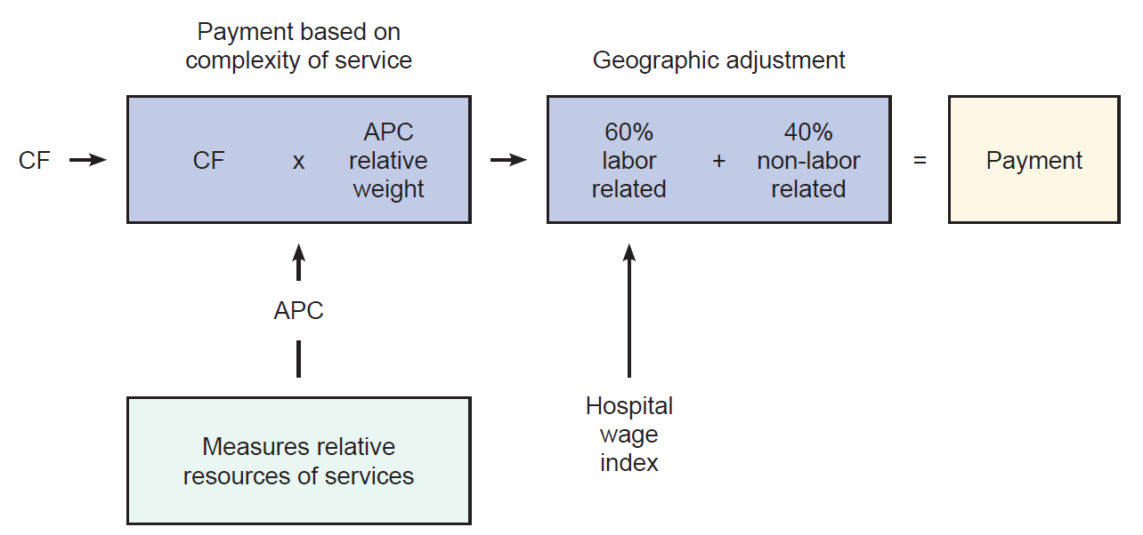
Determining the OPPS
Payment Rates
Notes:
Calculated by multiplying the scaled relative weight for services (based on clinical APC) by a conversion factor. This gives you a national unadjusted payment rate. The APC is designed to measure the resource requirements for a particular service or test and is calculated based on the geometric mean, which is a 2 year rolling average of reported costs based on hospital chargemaster reporting. The conversion factor (CF) translates the APC into a dollar amount. This rate is then adjusted for regional variations in labor costs. This is what establishes reimbursement and we appear to suffer from inaccurate cost capture/reporting under OPPS. We have to correct this now to improve reimbursement for the future.

Slide 27
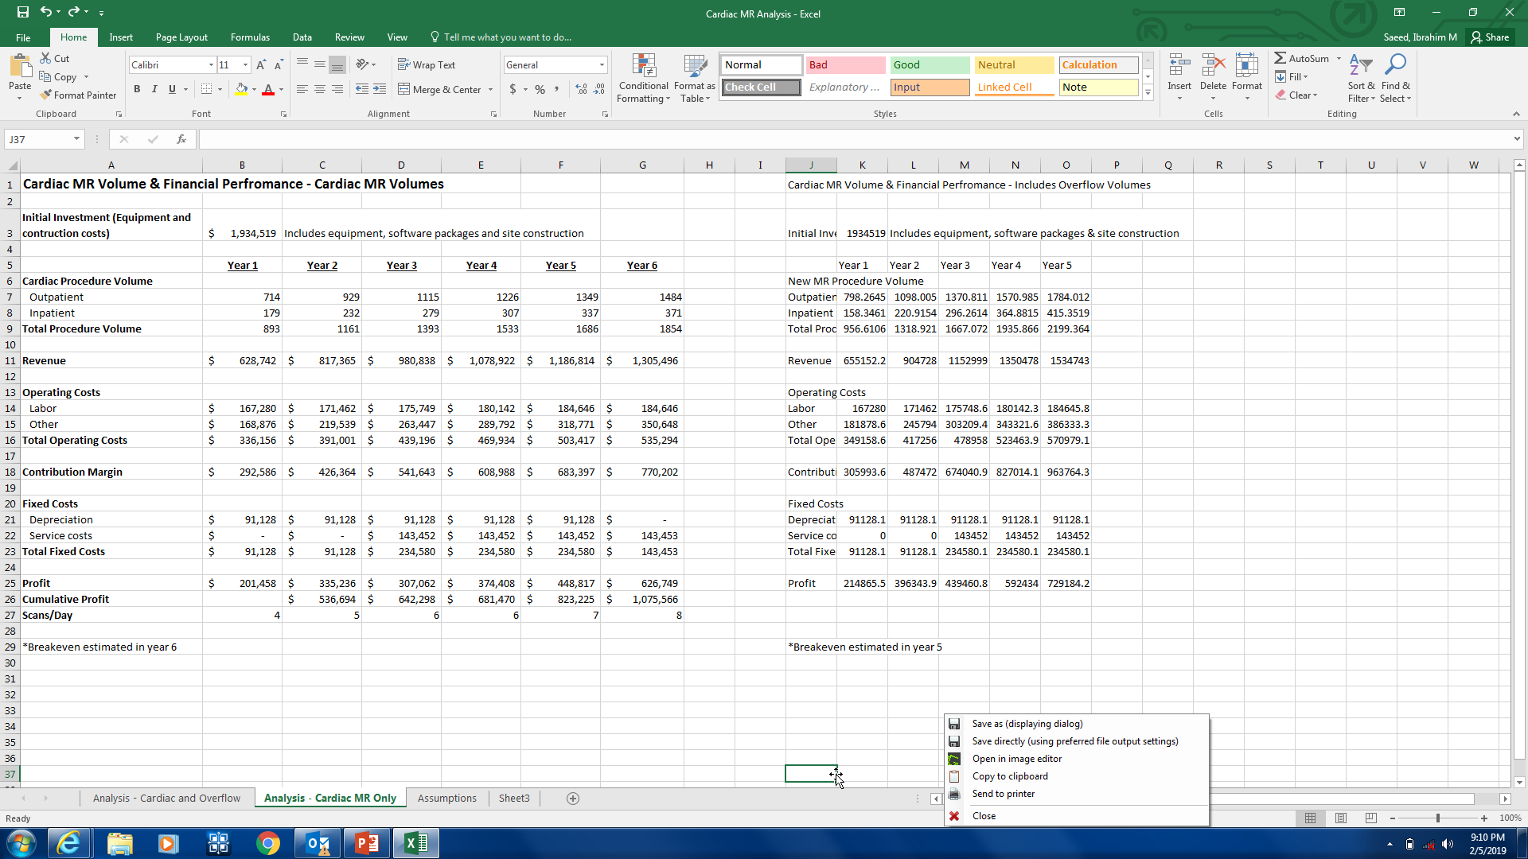
CMR

Slide 28
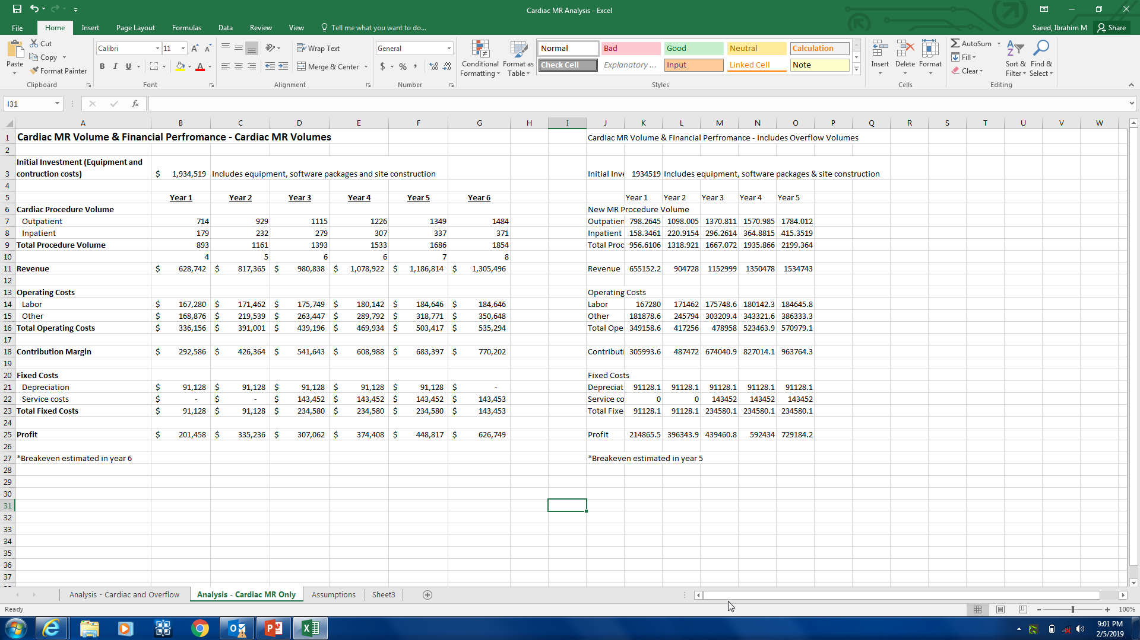
Besides CMR

